Slide 1
Modal verbs
may
to play
can
to do
must
should
What are they?
to see
want to
is
do
have

Slide 2
What do they do?
They MODIFY the meaning of the verb

Slide 3
modify
spelen
kunnen spelen
mogen spelen
moeten spelen
zou moeten spelen
willen spelen
play
can play
may play
must play
should play
want to play

Slide 4
Using modals
I can feed the lions
I could feed the lions
I can’t feed the lions
Can you feed the lions?
Present simple
Past simple
Ontkenning
Vraag

Slide 5
Means the same [synonyms]
can
may
must
should
be able to
be allowed to
have to/need (to)
ought to

Slide 6
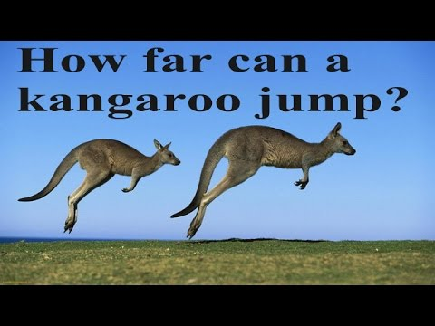
Using modals – can [mogelijk] - to be able to [kunnen]
present simple
negation
past simple
It can jump really far
It is able to jump really far
It can’t jump far.
It is not able to jump far.
It could jump far
yesterday
It was able to jump far
yesterday

Slide 7
Using modals – may [toestemming]
You may feed the animals. [b-keus]
You’re allowed to feed the animals. [beter]
Geen “may” in verleden tijd bij toestemming
I wasn’t allowed to feed the animals yesterday.
May I feed the animals? [beter]
Am I allowed to feed them?
[Can I feed them?]
present simple
past simple/negation
question (polite)
(often used)

Slide 8
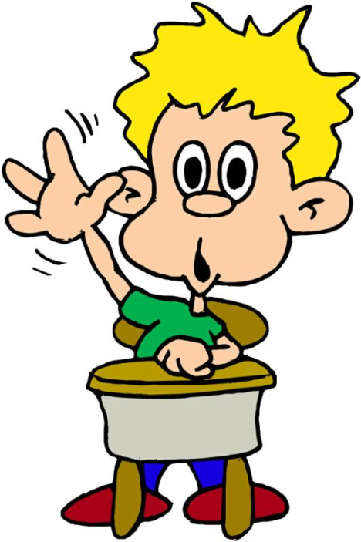
Sometimes it’s used differently
May I go to the toilet?
[1. toestemming]
I think it may(might) get windy soon.
[2. voorspelling] (misschien)

Slide 9
Using modals – may [misschien]
I may go outside . [b-keus]
I might go outside. [beter]
(geeft “misschien” aan)
Geen “voorspelling” in verleden tijd
Weinig als vraag
gebruikt .
Might it rain?
present simple
past simple/negation
question

Slide 10
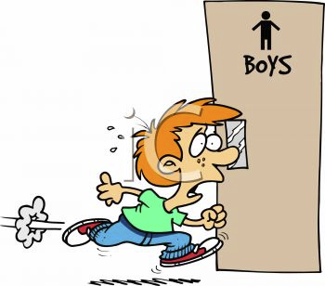
Using modals – must [dwingend] – have to [dwingend] - need to [nodig]
I must go to school. [b-keus]
I have to go to school. [beter]
I need to go to the toilet…
I mustn’t go to school
I don’t have to go to school
You need not feed it every day
I had to go to school
I needed to go to school to do …
present simple
negation
past simple

Slide 11
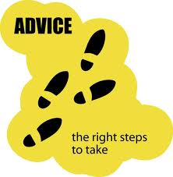
Zou moeten
You should eat lots of vegetables.
You ought to eat lots of vegies.
I should not eat so many sweets.
I ought not to eat so many sweets.
I should have eaten more.
I ought to have eaten more.
present simple
negation
present perfect

Slide 12
Using modals – want to [gewenst]
Note: [willen hebben] I want it all and I want it now!
I want to see that movie.
I don’t want to go
to school this morning.
I wanted to be a popstar when I was young.
I didn’t want to be a
popstar when I was young.

Slide 13
Homework
http://www.english-4u.de/modal_verbs_ex1.htm

