Slide 1
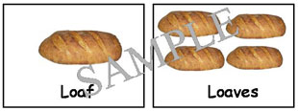
Plurals
Meervoud

Slide 2
The first rule
a car two cars a hat two hats
an eye two eyes a bed two beds
a pen two pens a friend two friends
an elephant two elephants a plate two plates
a lamp two lamps a teacher two teachers
a phone two phones an egg two eggs
an apple two apples a sock two socks
a colour two colours a bike two bikes

Slide 3
The second rule
a box two boxes a watch two watches
a bus two bus(s)es a witch two witches
a buzz two buzzes
a sandwich two sandwiches
xks z sss tch

Slide 4
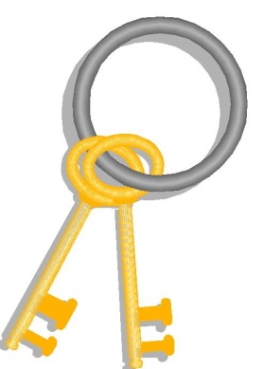
The third rule
Rule 3a
a city two cities a lady two ladies
a baby two babies a hobby two hobbies
Rule 3 b
a toy two toys a day two days
a guy two guys a key two keys

Slide 5

The fourth rule
a disco two discos a piano two pianos
a photo two photos a logo two logos
Exceptions:
a tomato two tomatoes a hero two heroes
a potato two potatoes
a mosquito two mosquito(e)s

Slide 6
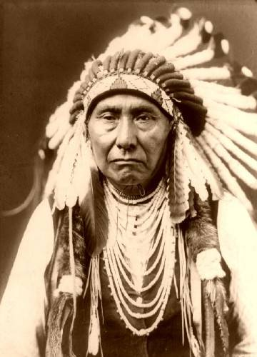
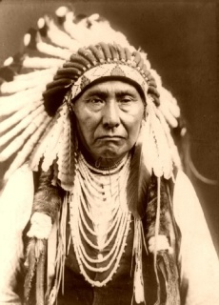

The fifth rule
a leaf two leaves a thief two thieves
a wife two wives a shelf two shelves
a cuff two cuffs a cliff two cliffs
a puff two puffs
Exceptions
a chief two chiefs a roof two roofs

Slide 7
Irregular
a child two children a man two men
a woman two women a tooth two teeth
a foot two feet a goose two geese
a fish two fish a sheep two sheep
a mouse two mice an ox two oxen
an analysis two analyses
a datum two data
a criterion two criteria
a basis two bases
Learn these!

Slide 8

Never, ever ……
‘
apostrophe with plurals

