Slide 1
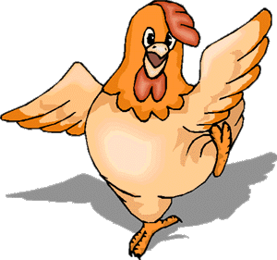
Welcome to Grammar’s chicken farm
© Mary Montanus-Stijnman

Slide 2
Present Simple lesson one – to be; to have
Get out a pen and a sheet of paper … we’re off!

Slide 3
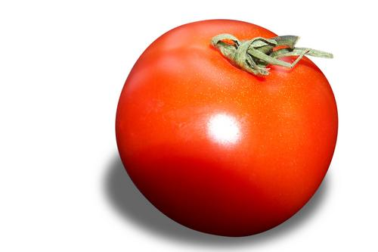
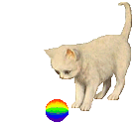
to be [zijn] to have (got) [hebben]
eigenschappen
dingen bezitten
The cat has (got) a ball.
Tomatoes are red.

Slide 4
Present simple - form
Important verbs – belangrijke werkwoorden
to be – zijn
to have (got) – hebben
I am
you are
he is
she is
It is
we are
you are
they are
I have
you have
he has
she has
it has
we have
you have
they have

Slide 5
Present simple – short form
Important verbs – belangrijke werkwoorden
to be – zijn
to have (got) – hebben
I am
you are
he is
she is
It is
we are
you are
they are
I’m
you’re
he’s
……
……
……
……
I have
you have
he has
she has
it has
we have
you have
they have
I’ve (got)
you’ve (got)
……
……
……
……
……

Slide 6
Present simple – negative form
Important verbs – belangrijke werkwoorden
to be – zijn
to have (got) – hebben
I am not
you are not
he is not
she is not
It is not
we are not
you are not
they are not
I’m not
You’re not
He isn’t
She isn’t
It isn’t
We aren’t
You aren’t
They aren’t
I haven’t (got) you haven’t (got)
he hasn’t (got)
she hasn’t (got)
it hasn’t (got)
we haven’t (got)
you haven’t (got)
they haven’t (got)

Slide 7
Present simple – question form
to be – zijn
to have (got) – hebben
I am
you are
he is
she is
It is
we are
you are
they are
Am I?
Are you?
Is he?
Is she?
Is it?
Are we?
Are you?
Are they
Have I (got)?
Have you (got)?
Has he (got)?
Has she (got)?
Has it (got)?
Have we (got)?
Have you (got)?
Have they (got)?

Slide 8
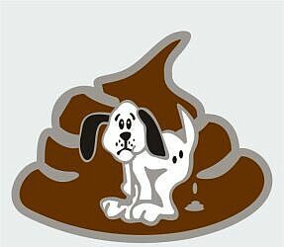
The SHIT rule
When the pronoun is SHE, HE or IT
… the verb form takes an “s”

Slide 9
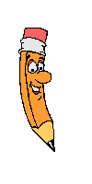
Testing, one, two, three
…what’s the pronoun?
My mother
Her brother
The dog
An apple
The people
Five cats
Your aunt
The newspaper article
My sister

Slide 10
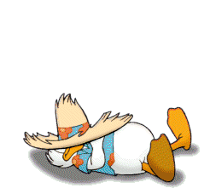
Wakey! Wakey! It’s time to practice

Slide 11
See yawl soon!
That’s all folks!

