Slide 1
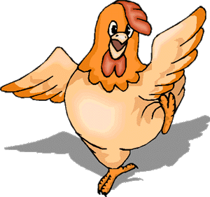
Welcome to Grammar’s chicken farm
© Mary Montanus-Stijnman

Slide 2
Present Simple lesson two - usage
Get out a pen and a sheet of paper … we’re off!

Slide 3
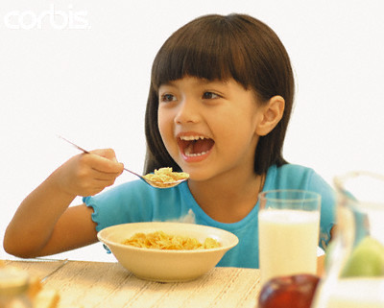
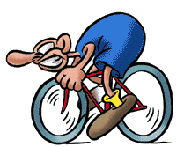
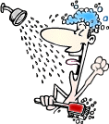
The present simple - usage
Habits - gewoontes
I always shower in the morning
She eats cornflakes for breakfast
I bike to school every day

Slide 4
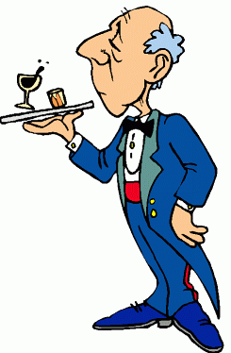
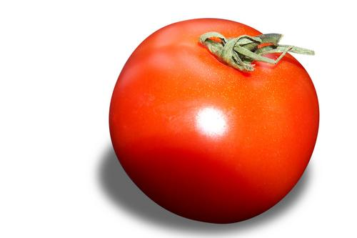
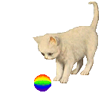
Present simple - usage
Facts - feiten
He is a butler.
Tomatoes are red.
The cat has got a ball.

Slide 5

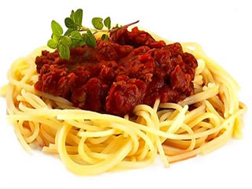
Present simple - usage
Feelings – thoughts – opinions
I like spaghetti
I think he’s funny

Slide 6
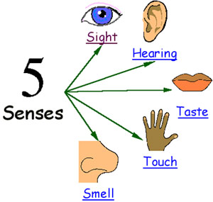
Present simple - usage
Observations – using the senses
I see lovely colours
It tastes funny

Slide 7
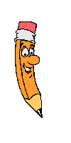
Verb form
 | I | you | he | she | it | we | they
ask | ask | ask | asks | asks | asks | ask | ask
tell
think
eat
write
read
see
go |  |  | goes
do |  |  | does

Slide 8
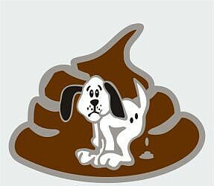
The SHIT rule
When the pronoun is SHE, HE or IT
… the verb form takes an “s”

Slide 9
Testing, one, two, three
…what’s the pronoun?
My mother
Her brother
The dog
An apple
The people
Five cats
Your aunt
The newspaper article
My sister

Slide 10
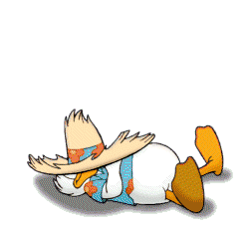
Wakey! Wakey! It’s time to practice

Slide 11
See yawl soon!
That’s all folks!

