Slide 1
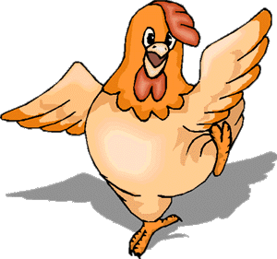
Welcome to Grammar’s chicken farm
© Mary Montanus-Stijnman

Slide 2
Present Simple
Lesson three
Questions & negations
Get out a pen and a sheet of paper … we’re off!

Slide 3
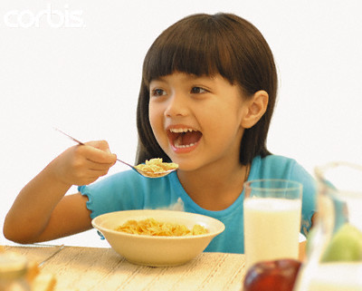
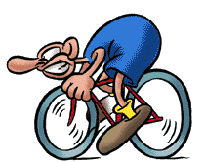
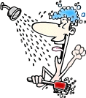
The present simple - usage
Habits - gewoontes
I always shower in the morning
She eats cornflakes for breakfast
I bike to school every day

Slide 4
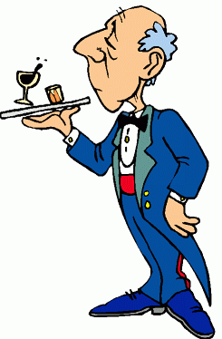
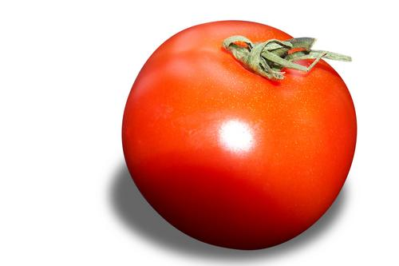
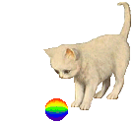
Present simple - usage
Facts - feiten
He is a butler.
Tomatoes are red.
The cat has got a ball.

Slide 5

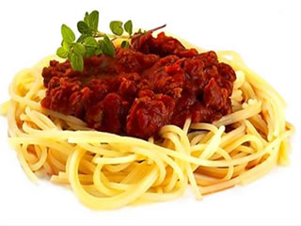
Present simple - usage
Feelings – thoughts – opinions
I like spaghetti
I think he’s funny

Slide 6
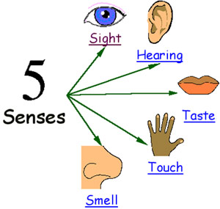
Present simple - usage
Observations – using the senses
I see lovely colours
It tastes funny

Slide 7

How do you form a question? use (do) + verb
        I always shower in the morning.
Do I always shower in the morning?
        She eats cornflakes for breakfast.
Does she eat cornflakes for breakfast?
        I bike to school every day.
Do I bike to school every day?
        They like spaghetti.
Do they like spaghetti?
        He thinks she’s funny.
Does he think she’s funny?

Slide 8
Make a question?
With the verb “to be”… no help needed
He is a butler
Is he a butler?
Is the dog happy?
Are they at school today?
Are you bored?
Am I a good student?

Slide 9

Make a question?
without do …
The cat has got a ball
Has the cat got a ball?
I can swim.
Can I swim?
You will wash the car!
Will you wash the car?
I would like a cup of tea.
Would you like a cup of tea?
Shall I do the dishes?
You should speak this way
Should you speak that way?
You must drive slowly
Must I drive slowly?
No help (do) needed …
to be
have got
can/could
will/would
shall/should
must

Slide 10
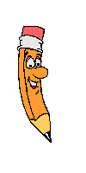
Testing, one, two, three form a question
My mother / like / hot dogs.
Her brother / hate / girls.
The dog / eat / dog biscuits.
An apple / keep / the doctor away.
The people / ask / any questions.
Five cats / can be / too much for one dog.
Your aunt / visit / very often.
The newspaper article / is / true.
My sister/ have got / braces on her teeth.

Slide 11
How do you form a negation? use (do) + not + verb
        I always shower in the morning.
I don’t always shower in the morning.
        She eats cornflakes for breakfast.
She doesn’t eat cornflakes for breakfast.
        I bike to school every day.
I don’t bike to school every day.
        They like spaghetti.
They don’t like spaghetti.
        He thinks she’s funny.
He doesn’t think she’s funny.

Slide 12
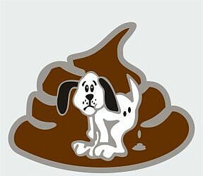
The SHIT rule
When the pronoun is SHE, HE or IT
… the auxiliary form takes an “s”

Slide 13
Testing, one, two, three make a negative sentence with each subject
My mother / like / hot dogs.
Her brother / hate / girls.
The dog / eat / dog biscuits.
An apple / keep / the doctor away.
The people / ask / any questions.
Five cats / be / too much for one dog.
Your aunt / visit / very often.
The newspaper article / is / true.
My sister/ have got / braces on her teeth.

Slide 14
See yawl soon!
That’s all folks!

